Slide 1
Call for Code Challenge
Track:- Covid-19
Team:- hack linguist

Slide 2
Problem Statement
At times of Emergency, finding a relevant hospital or Relief Centre becomes the major challenge.
Even in pandemic like situations, many people do not know exactly what to do in panic situations.
At times of Emergency, it becomes difficult to contact people instantly.
Every year, thousands of people die because they cannot reach in time.

Slide 3
Providing help for Survival
Our Product will provide the required information and how to deal these pandemic situations.
It will guide the exact route to hospitals or Relief Centre.
It will help people to reach in time and act as a life savior.
It will help to contact people in case of emergency.
It is cost effective as it does not need any electronic equipment.
Only deployment is required on ibm cloud.

Slide 4
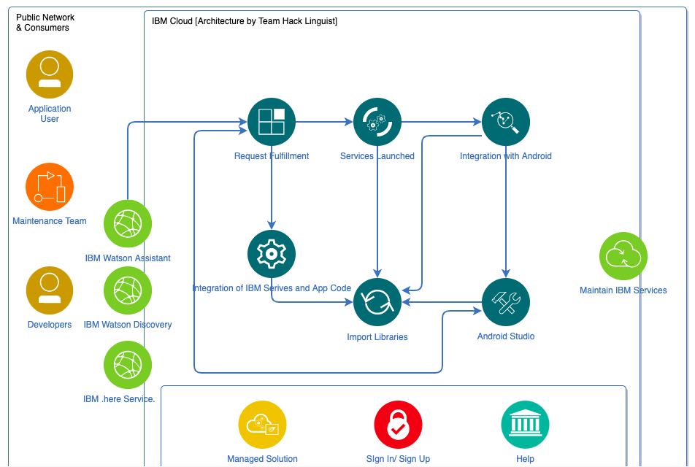
Architecture Diagram

Slide 5
IBM Services and Links
IBM Watson Assistant
IBM Watson Discovery
.here
Git link for Android app:- https://github.com/siddhi1599/CovidResQ-RoadResQ-
Link for Assistant Service:-
https://web-chat.global.assistant.watson.cloud.ibm.com/preview.html?region=eu-gb&integrationID=8b7bb1a4-6751-4aba-94d6-b6681515e7bd&serviceInstanceID=8e30635b-4b1a-4e51-9c0f-2f5d645805ea

Slide 6
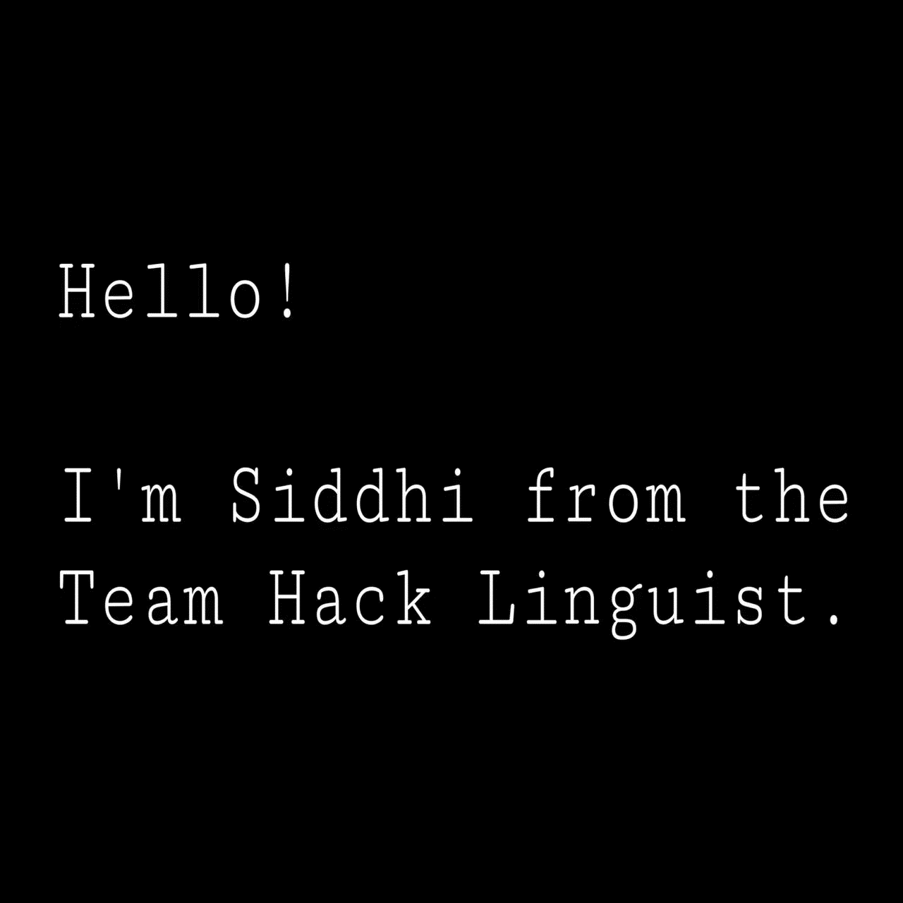
Video

Slide 7
Future Scope
Connect with nearby shops to help people who are in emergency situation.
Connect with hospitals to people who are in panic.
Provide no of nearest police stations, fire departments in future.

Slide 8
Thanks!!
Q/A

